Slide 1
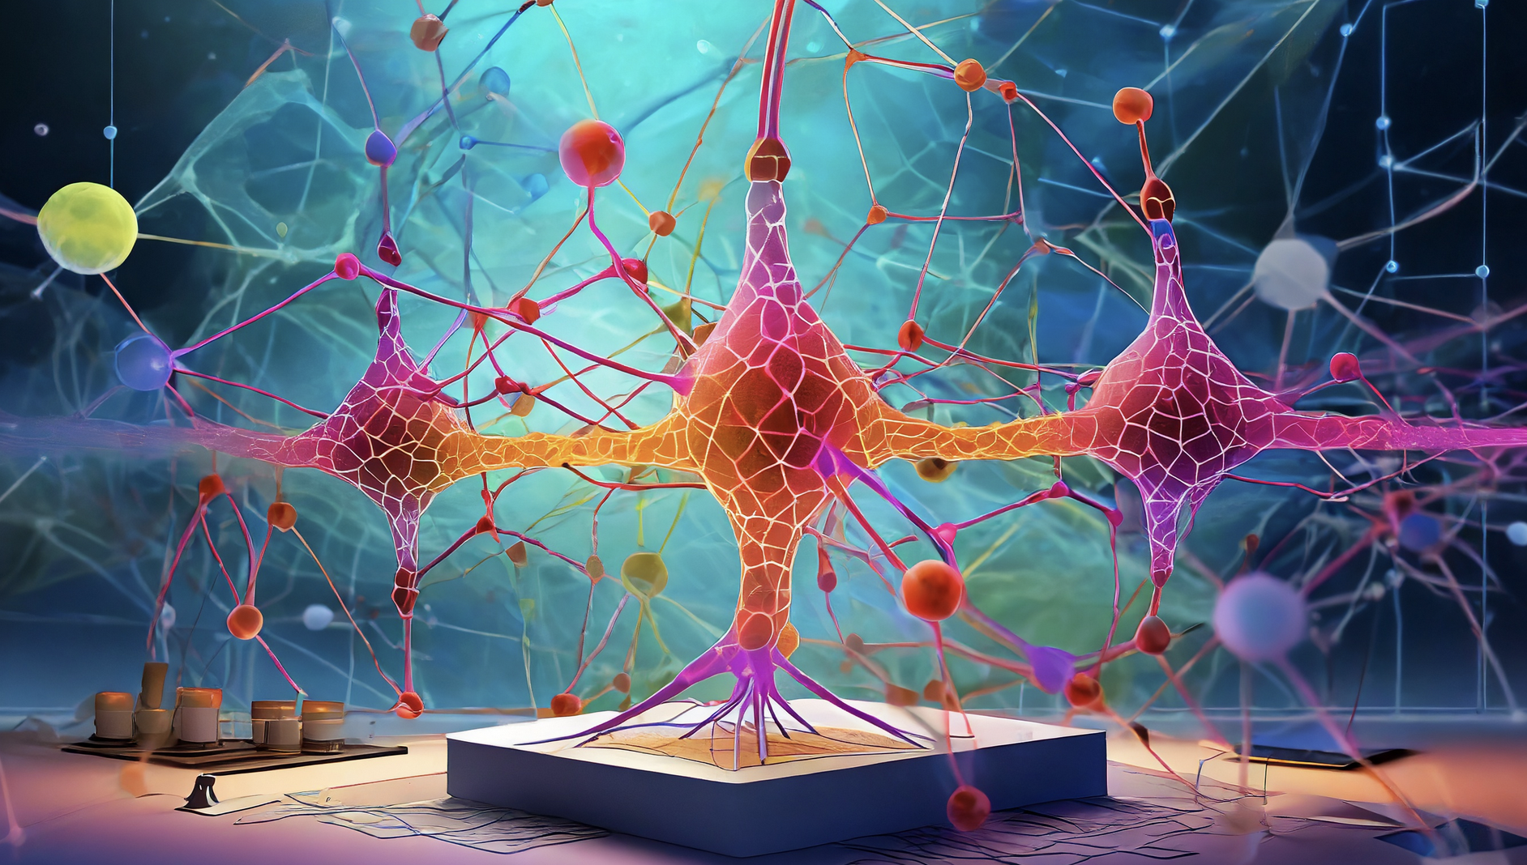

PET reconstruction deep learning hands on
IEEE MIC image reconstruction and AI short course 2023
georg.schramm@kuleuven.be

Slide 2
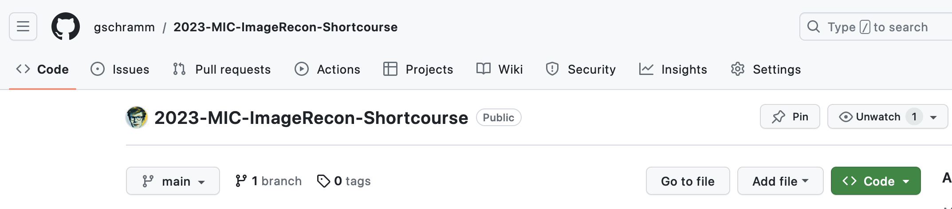
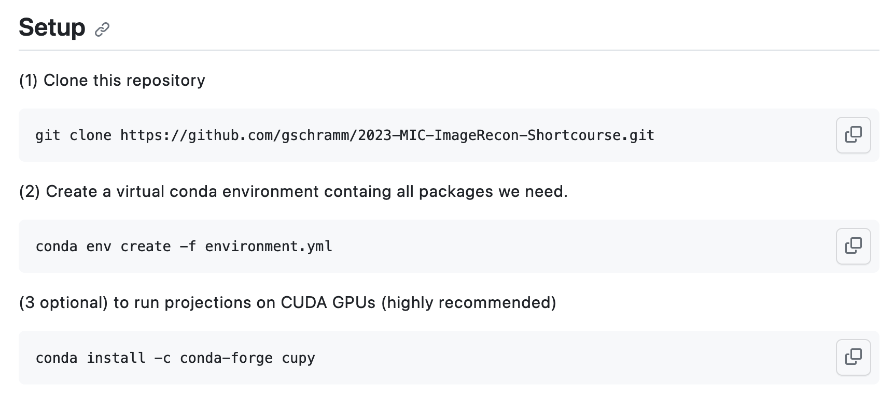
Today’s hands-on examples

Slide 3
Motivation

Slide 4
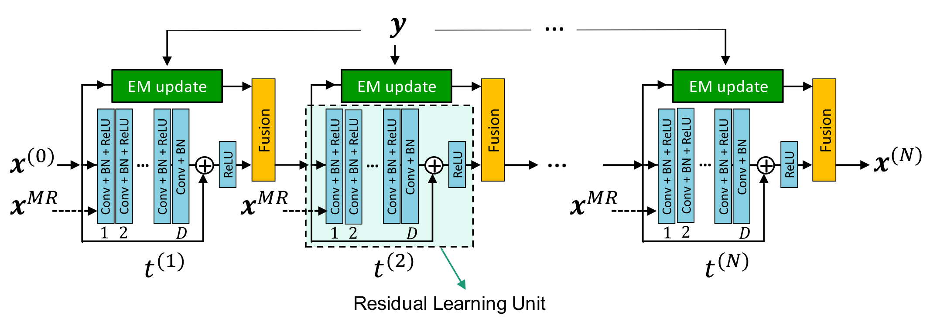
Our goal for today: understand training of ”projection” networks
Challenge separate + understand the essential blocks (bricks)
Looks like building LEGO …

Slide 5

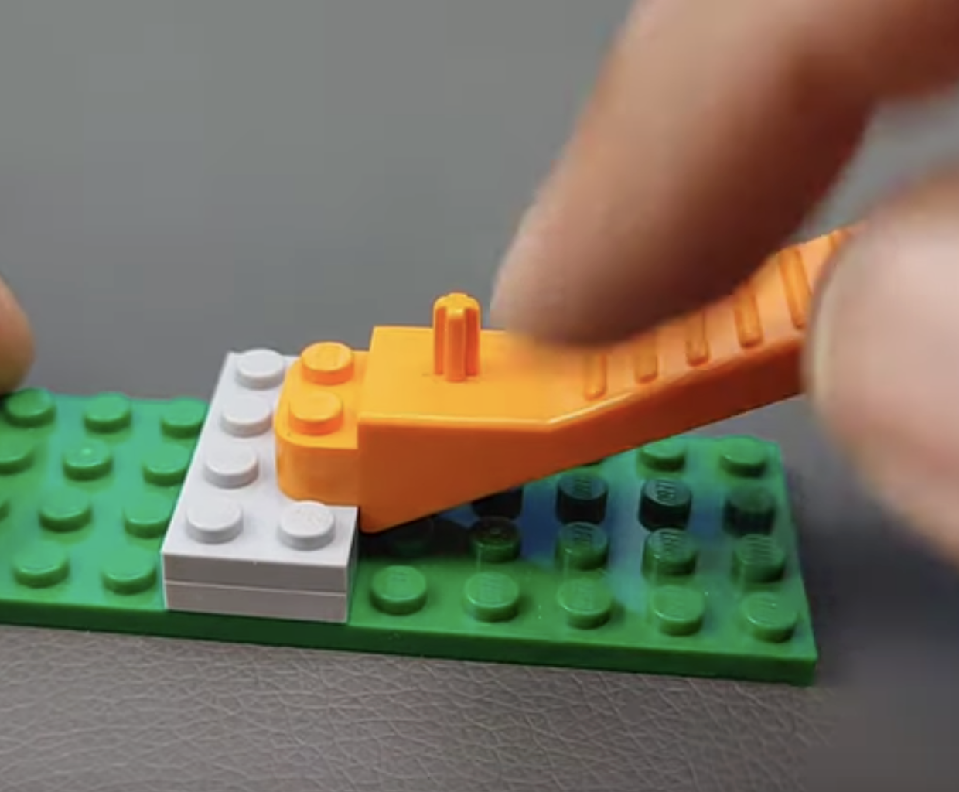



Every job gets easier knowing the right tools …
https://www.youtube.com/watch?v=23AhAxJwbUg

Slide 6
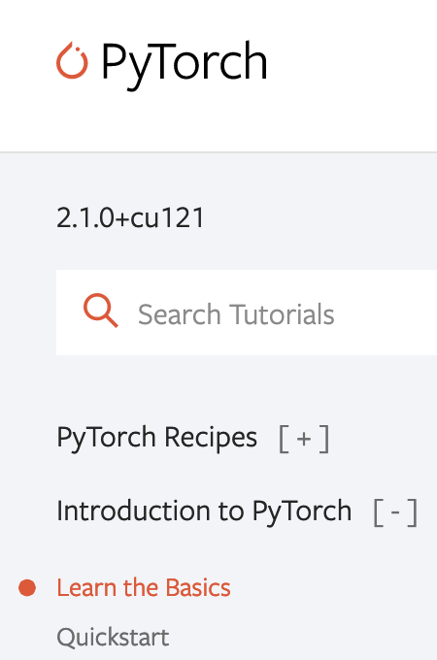
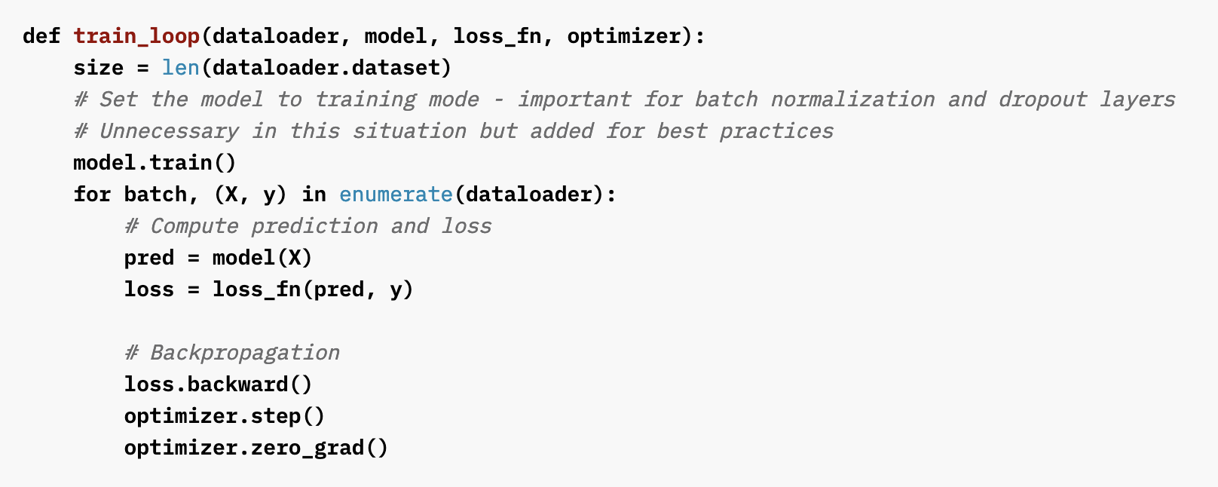
Training a ML model in pytorch (is easy?)
3 key ingredients (we need to understand)
How to define a feed-forward model (including projections + back projections)
How to use pytorch’s autograd for backpropagation of gradients
How to efficiently load / feed data during training
https://pytorch.org/tutorials/beginner/basics/optimization_tutorial.html

Slide 7
Learning Objectives + Disclaimer
what this tutorial is about
what we won’t cover
How to efficiently project 3D pytorch (GPU) tensors for realistic PET scanner geometries
How to setup pytorch “projection” layers compatible with pytorch autograd functionality
How to train pytorch “PET projection” models
How to read data from real PET scanners
How to implement geometry of a specific PET scanner
How to obtain correction sinograms / data
Training a complete network in 90min ;)
Today’s aim Understading computational tools / essential blocks for training PET reconstruction networks transferable to real world PET data

Slide 8
Projecting pytorch GPU tensors

Slide 9
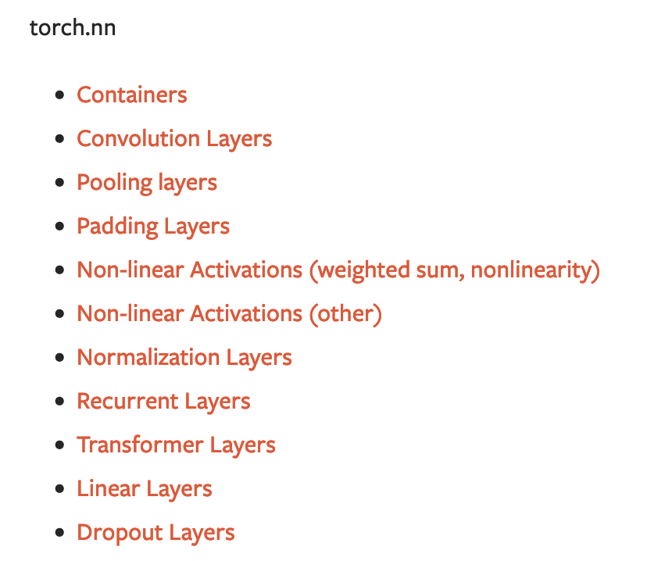
Setup / Training of a “standard” NN in pytorch is easy …
standard NN layers are already implemented
BUT: Projection / EM update layers not available in pytorch :(
https://pytorch.org/tutorials/beginner/basics/buildmodel_tutorial.html
https://pytorch.org/docs/stable/nn.html

Slide 10
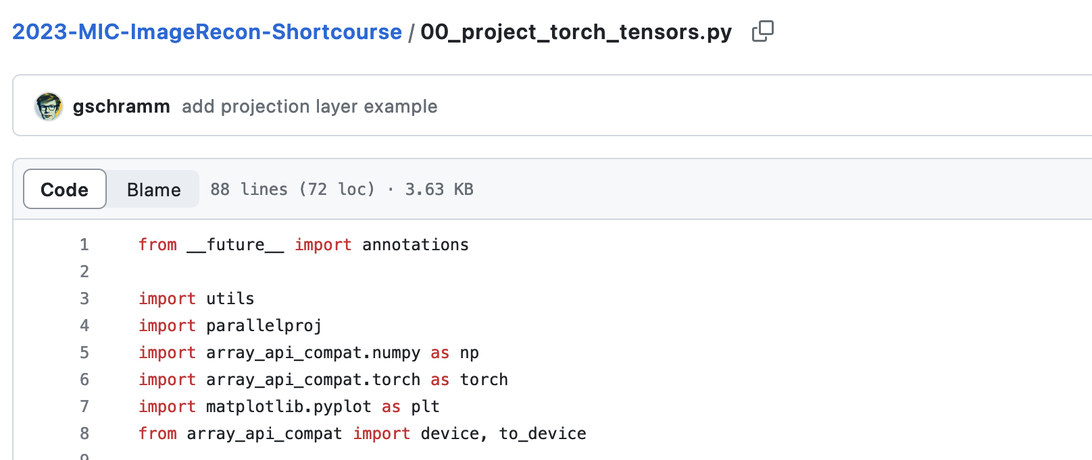
Projection pytorch (GPU) tensors
Learning Objective I How to efficiently forward / back project 3D images stored in pytorch (GPU) tensors
Later today How to wrap projectors into a pytorch layer (function) compatible with autograd

Slide 11
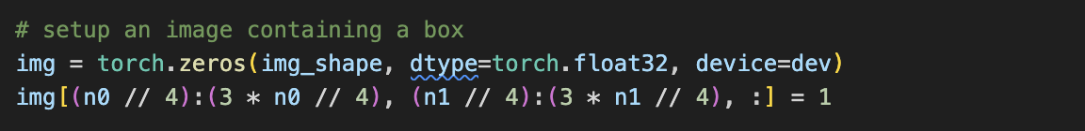
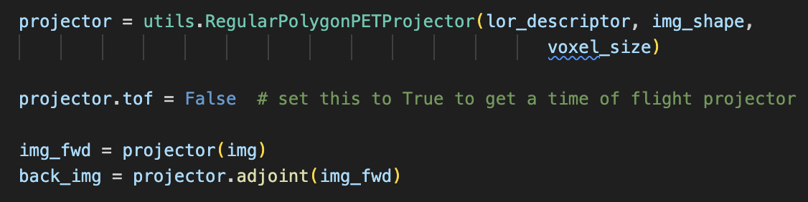
Summary + Learnings I
Projecting / back projecting pytorch GPU arrays (tensors) is “easy” using parallelproj

Slide 12
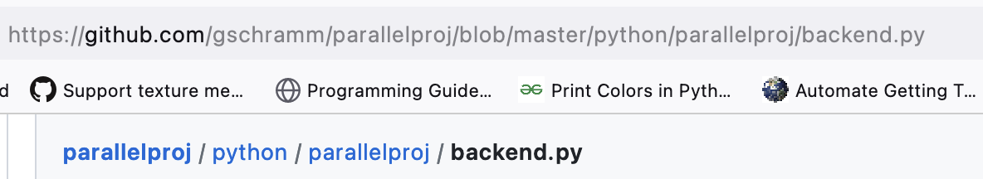

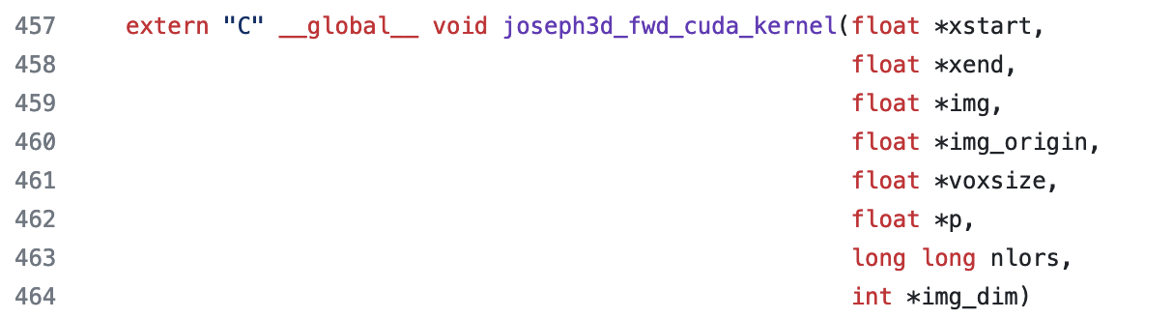
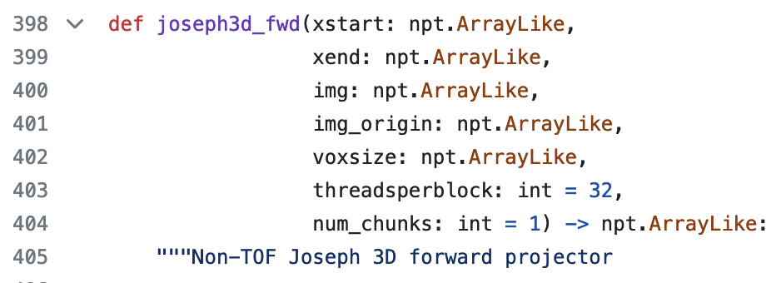
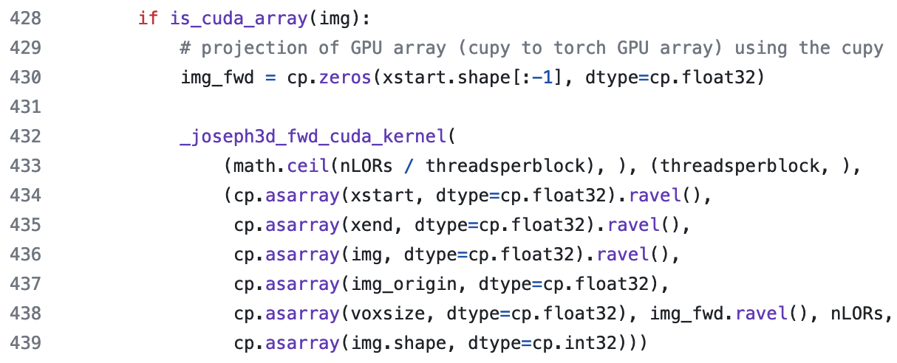
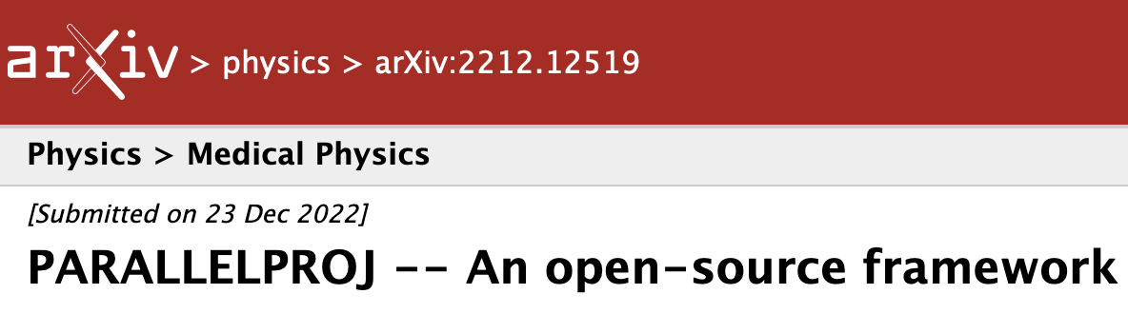
Parallelproj deep dive (optional)
direction execution of projection CUDA kernels on (torch) CUDA arrays
very flexible, only needs LOR start end end points
non-TOF and TOF mode
sinogram and listmode
python array API compatible

Slide 13
Implementing an EM Update module using projection layers and autograd

Slide 14
EM update module as a computational graph
EM update as composition of “simple” functions
forward projection of image x
addition of contamination sinogram b
pointwise division of sinograms m and q
back projection of sinogram y
pointwise division of images s and A^{T} 1
complicated function … let’s “unroll” it into elementary “blocks”
pointwise multiplications of images x and t

Slide 15

EM update module as a computational graph
only 2 layers/blocks (functions) not available in pytorch
forward projection of image x
back projection of sinogram y
we learned how to compute those -> ready to train our model?
Not yet! Why?

Slide 16
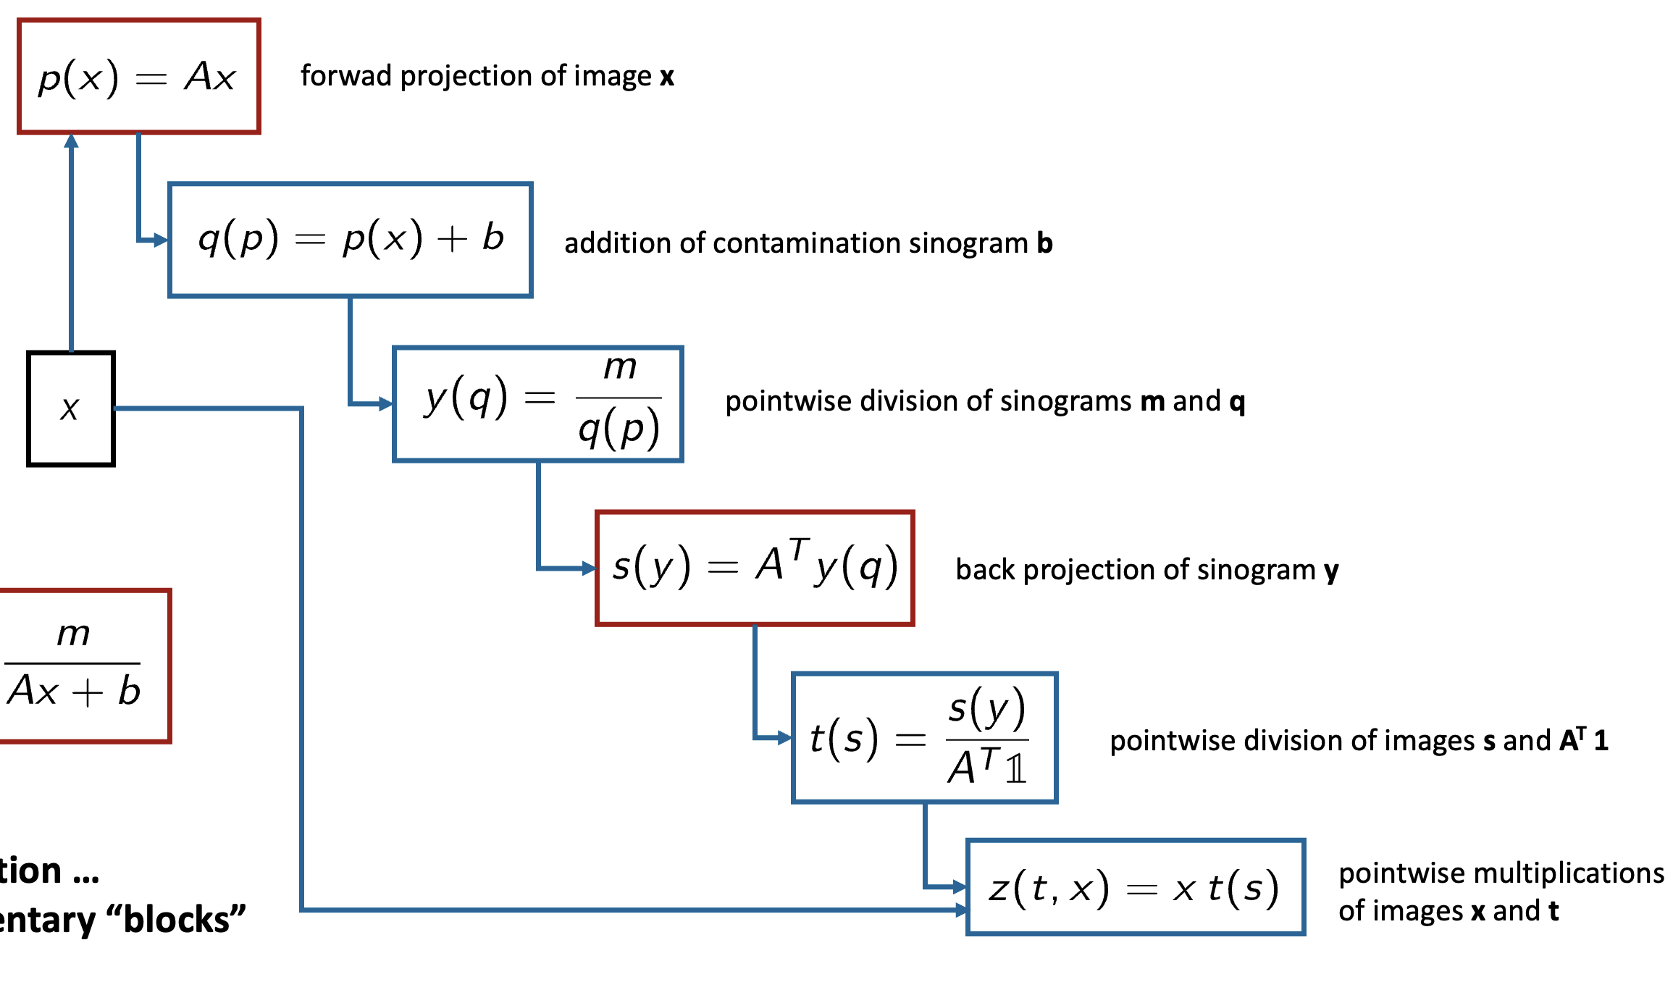

EM update module as a computational graph
forwad projection of image x
back projection of sinogram y
“chain” rule of unrolled EM update
training needs gradient back propagation!
sloppy notation: z(x), p(x), s(y) are vector valued functions What do we actually need for pytorch’s autograd?

Slide 17
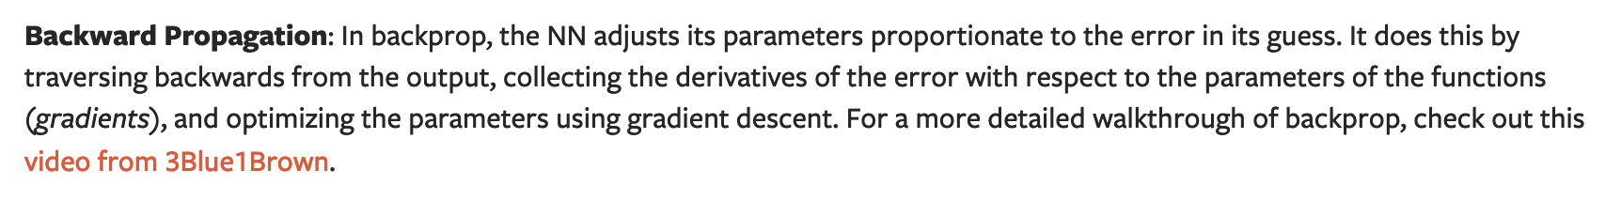
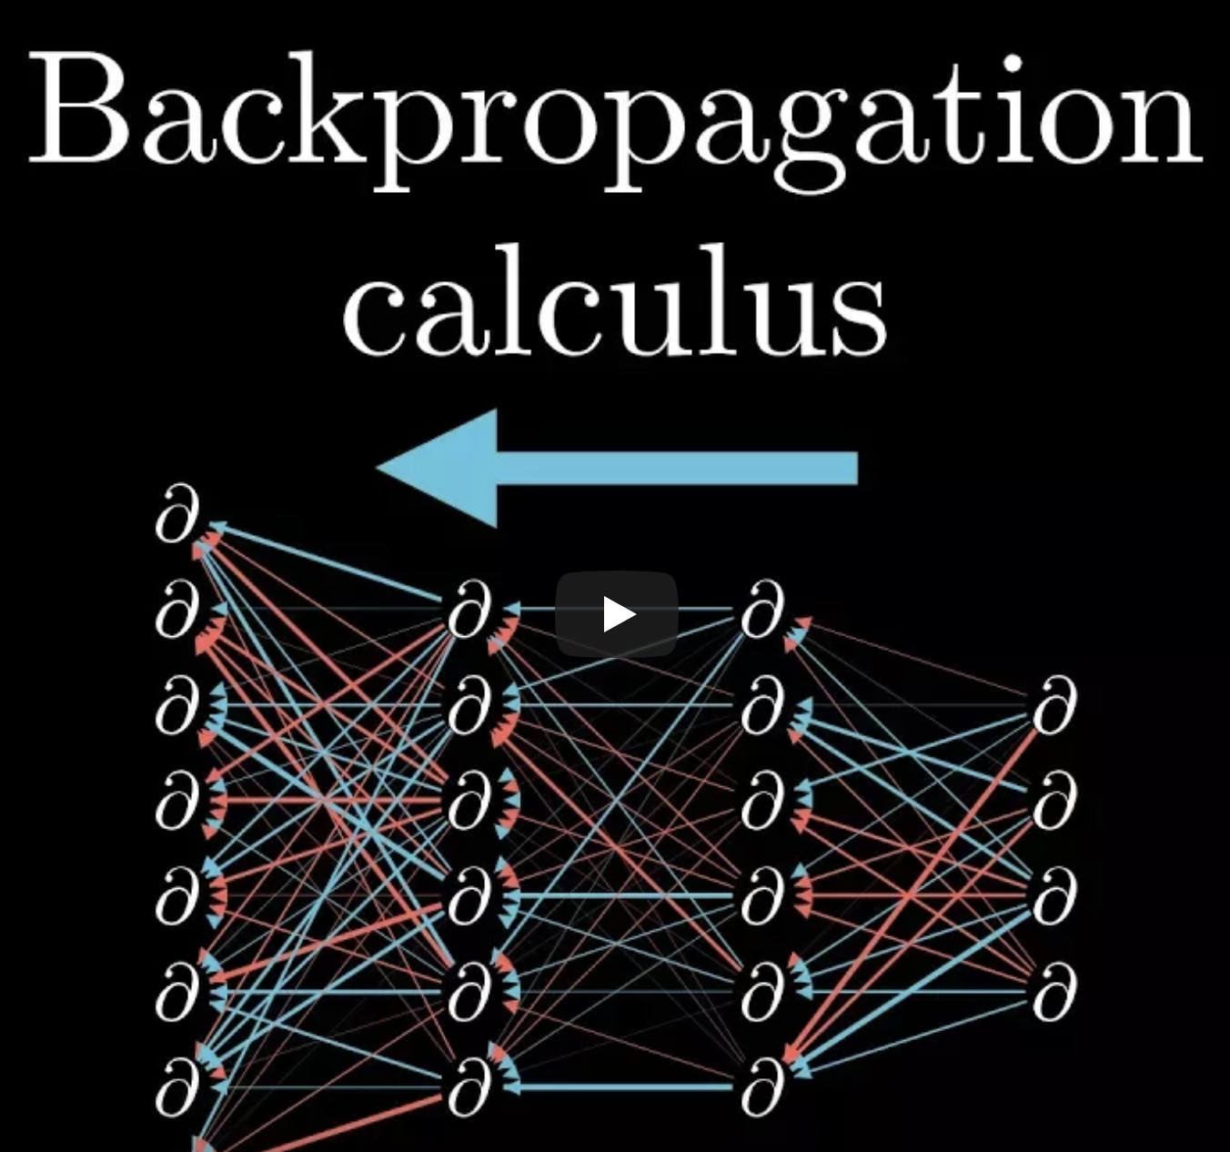
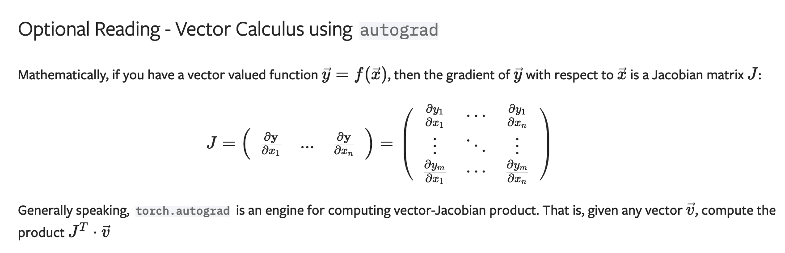
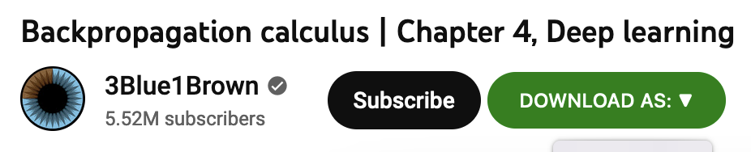
Pytorch’s autograd
evaluated in backward pass of any layers
https://pytorch.org/tutorials/beginner/blitz/autograd_tutorial.html#a-gentle-introduction-to-torch-autograd https://www.youtube.com/watch?v=tIeHLnjs5U8

Slide 18
Backward pass of forward and backprojection layers
forward projection layer
back projection layer
vector-value forward pass
elements of the Jacobian
Jacobian operator (matrix)
transpose of Jacobian applied to vector (what we need in the backward pass)

Slide 19
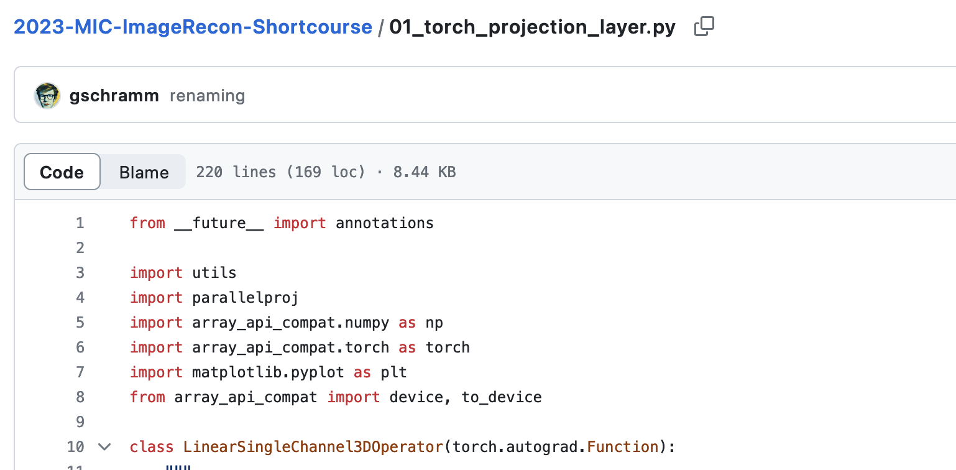
Implementing + testing forward / back projection layers
Question: Why do we need gradient of EM update block w.r.t to x if we want to optimize network parameters 𝞱 ?
Learning objectives II
implement custom forward and back projection functions (layers)
Implement backward pass to make them autograd compatible
Learn how to check gradient (backward pass) implementation using autograd.gradcheck
https://pytorch.org/tutorials/beginner/examples_autograd/two_layer_net_custom_function.html https://pytorch.org/docs/stable/notes/extending.html#how-to-use

Slide 20
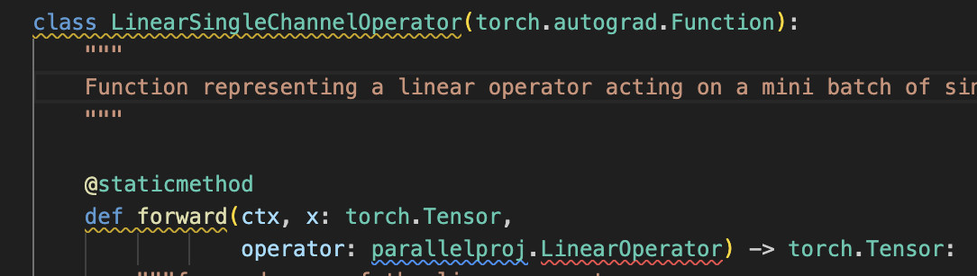
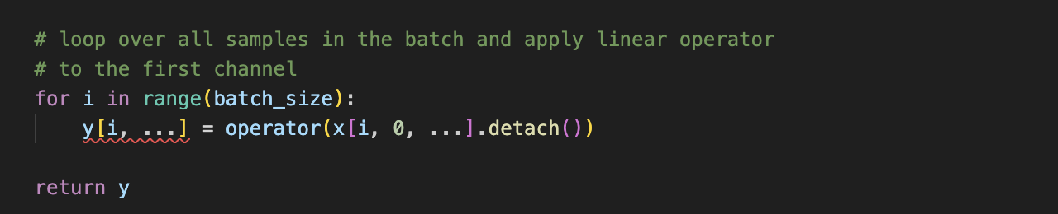

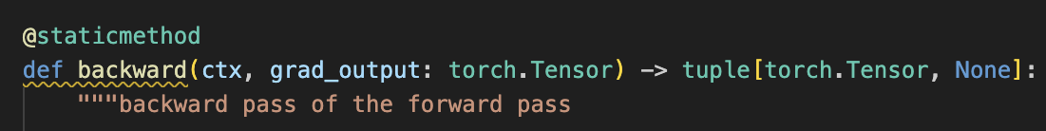
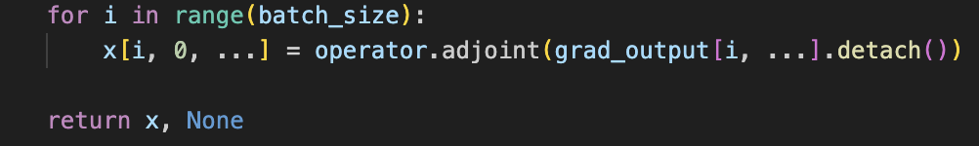
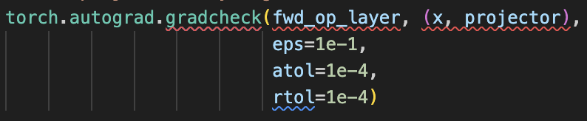
Summary + Learnings II
pytorch layers act on mini-batchs of tensors with possibly multiple channels 3D images -> 5D tensor (batch, channel, n0, n1, n2)
Always use torch.autograd.gradcheck for new custom layers!
“v” is passed as “grad_output”

Slide 21
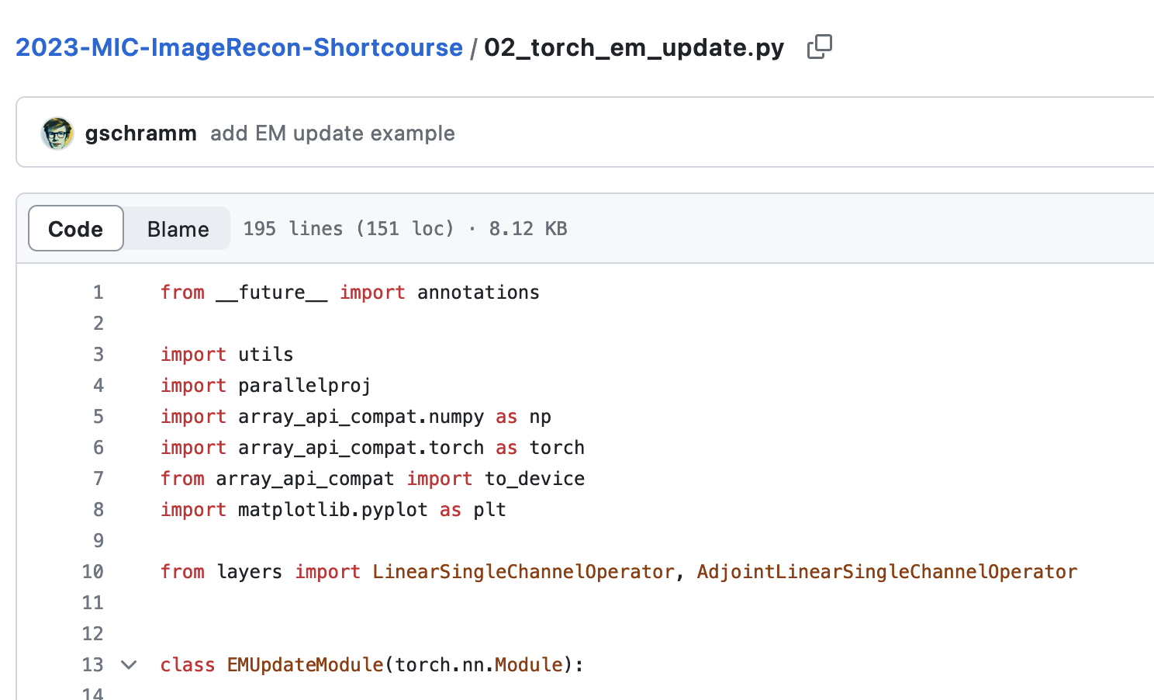
Implementing EM update block / MLEM recon
Learning objectives III
implement a complete (Poisson) EM update block
Running a simple MLEM recon using the EM update blocks

Slide 22
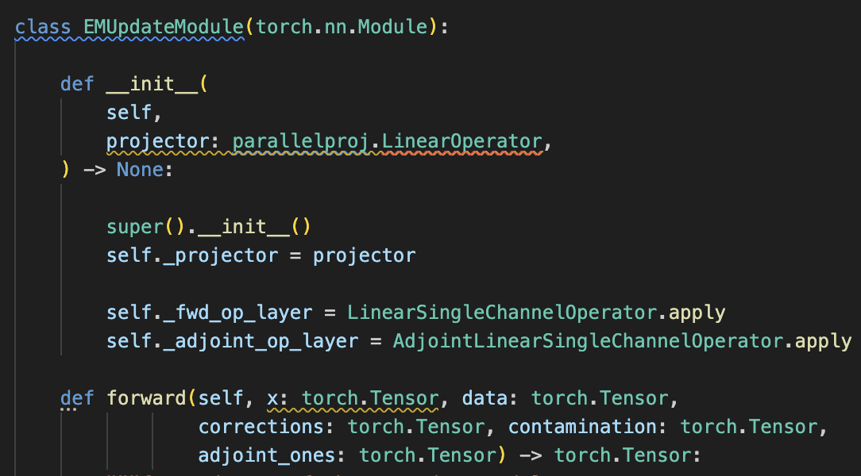
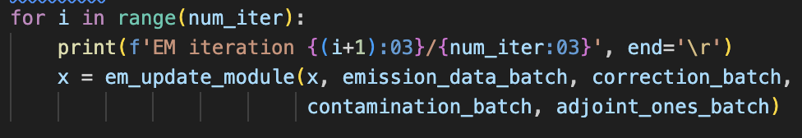
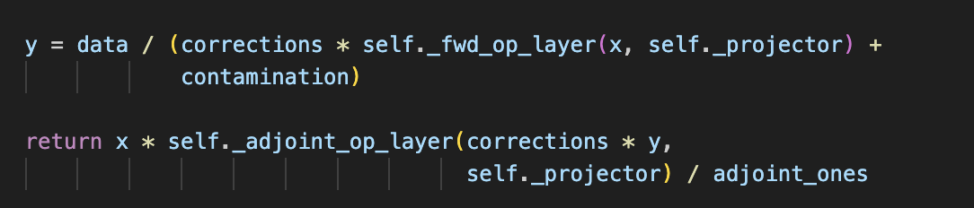
Summary + Learnings III
EM Update Module compatible with pytorch’s autograd is implemented ☺

Slide 23
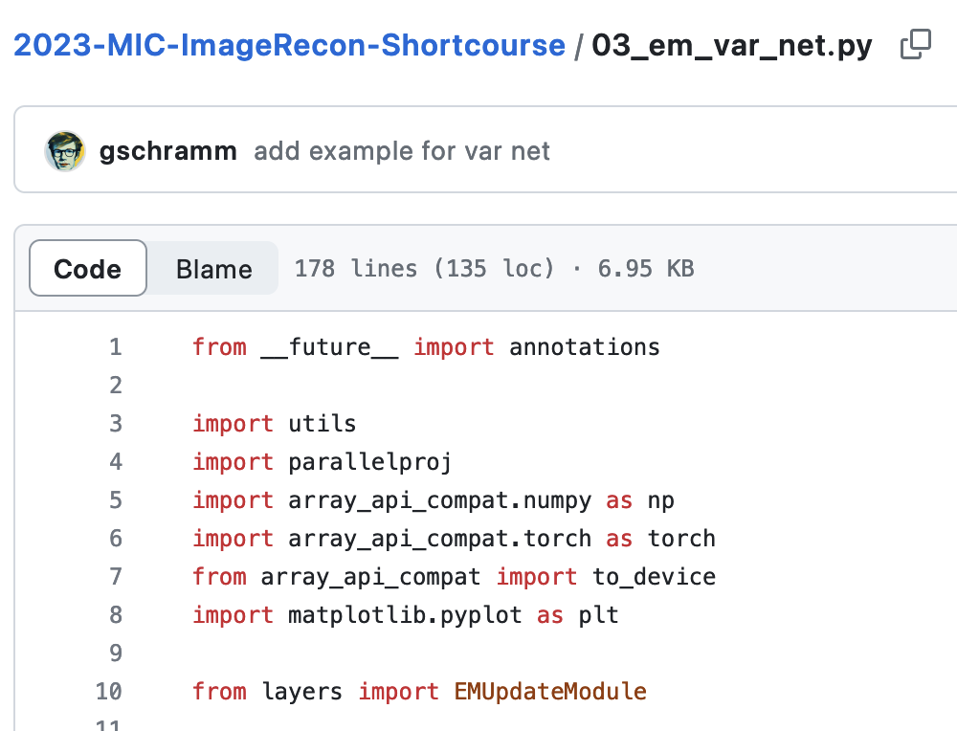
Implementing a simple unrolled EM variational network
Learning objectives IV
implement a complete unrolled variational network fusing EM + NN updates

Slide 24
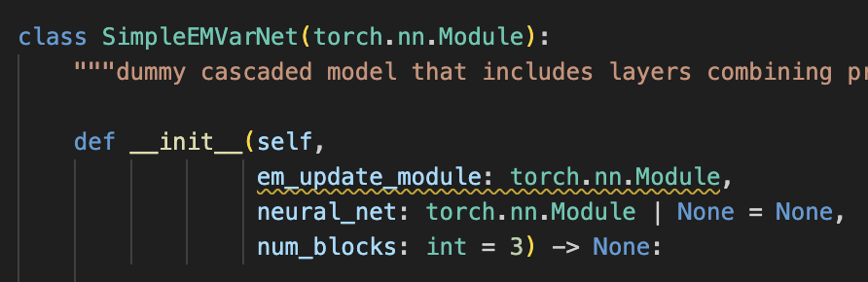
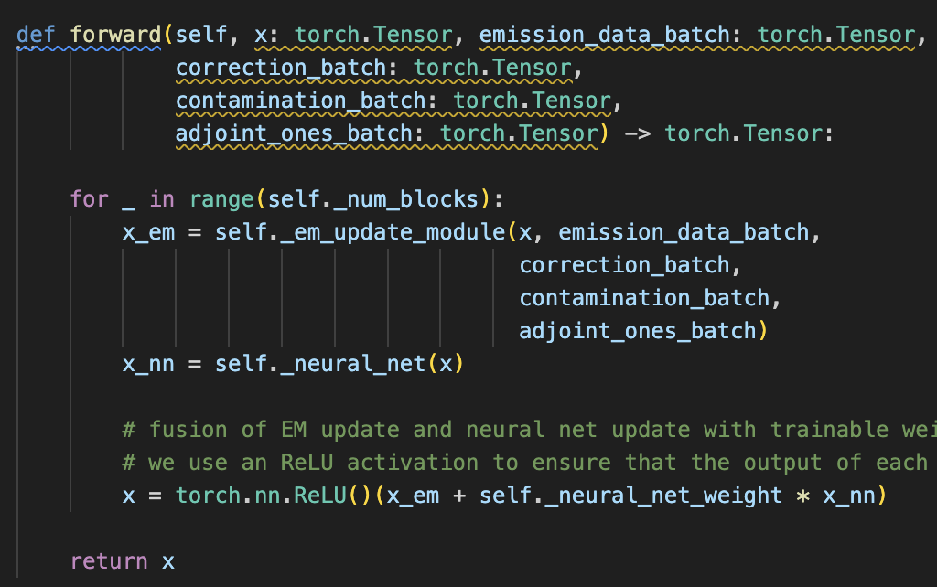
Summary + Learnings IV
Fusion of EM + neural network (NN) update in forward pass is trivial ☺
unrolled EMVarNet compatible with pytorch’s autograd available ☺
model ready for training ☺

Slide 25
Efficient data handling (data loaders)

Slide 26
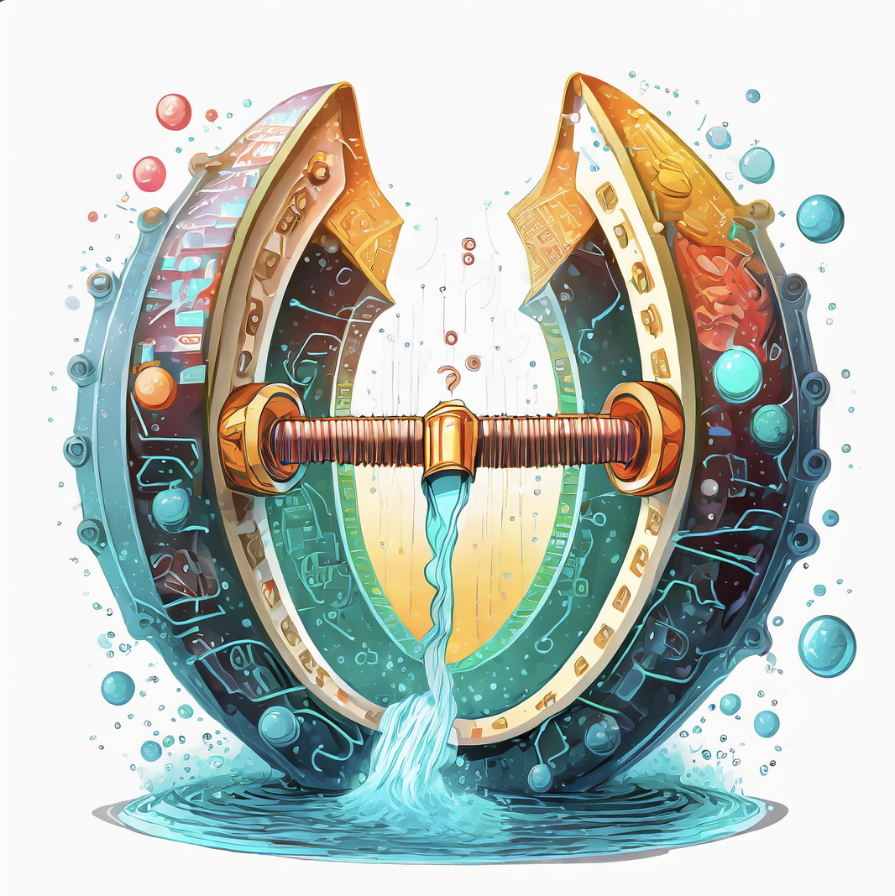
Motivation
input X: mini batch of emission, correction + contamination sinograms, sensitivity images …
label y: mini batch of “high quality” images
realistic data sets (sinograms + 3D images) are too big to be kept in memory (several GBs) -> load data “on-the-fly” from disk
input / output must be also transferred from host to CUDA GPUs
Important avoid that data loading + transfer to GPU becomes the bottle neck (slower than forward pass + gradient back propagation)

Slide 27
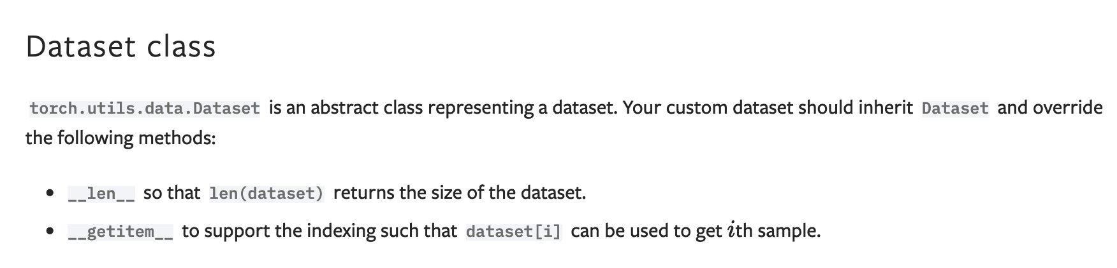

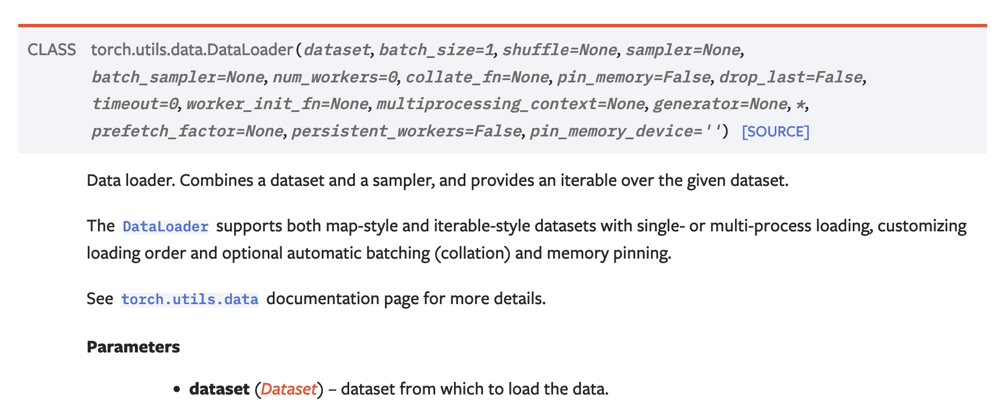
Pytorch datasets and dataloaders
Aim: Decouple (code of) data loading and network training
a dataloader generated by adobe firefly

Slide 28
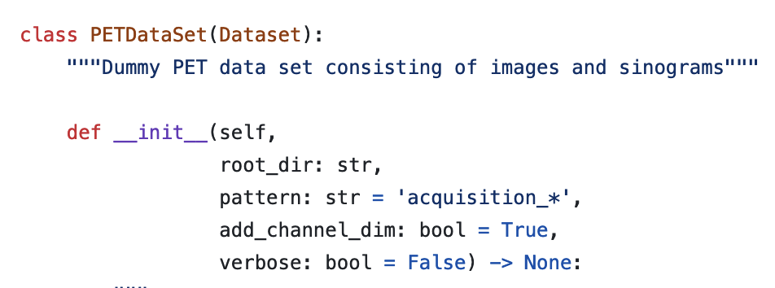
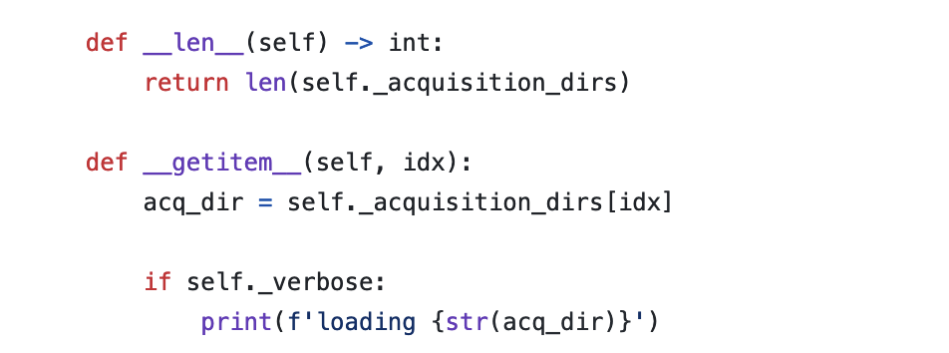
Pytorch datasets
map-style dataset that loads all tensors we need for one elements in our complete data set (here: e.g. emission sinogram, contamination sinogram, sensitivity images, …)
need to implement __len__(self) and __getitem__(self) methods
__getitem__(self, idx) can return dictionary or tuple of tensors
can be combined with transforms for on-the-fly data augmentations
https://pytorch.org/tutorials/beginner/data_loading_tutorial.html https://pytorch.org/tutorials/beginner/basics/data_tutorial.html https://pytorch.org/docs/stable/data.html#map-style-datasets

Slide 29
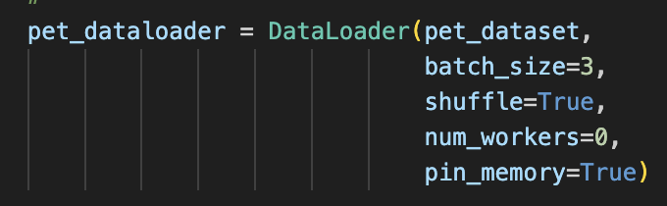
Pytorch dataloader
combines a list of items from DataSet into a mini-batch
can use multiple worker threads (usefule for CPU-based transforms)
pinned memory for faster transfer to GPU
collate_fn arg. allows to use custom function that defines how items are combined into mini batches (e.g. along which tensor axis)

Slide 30
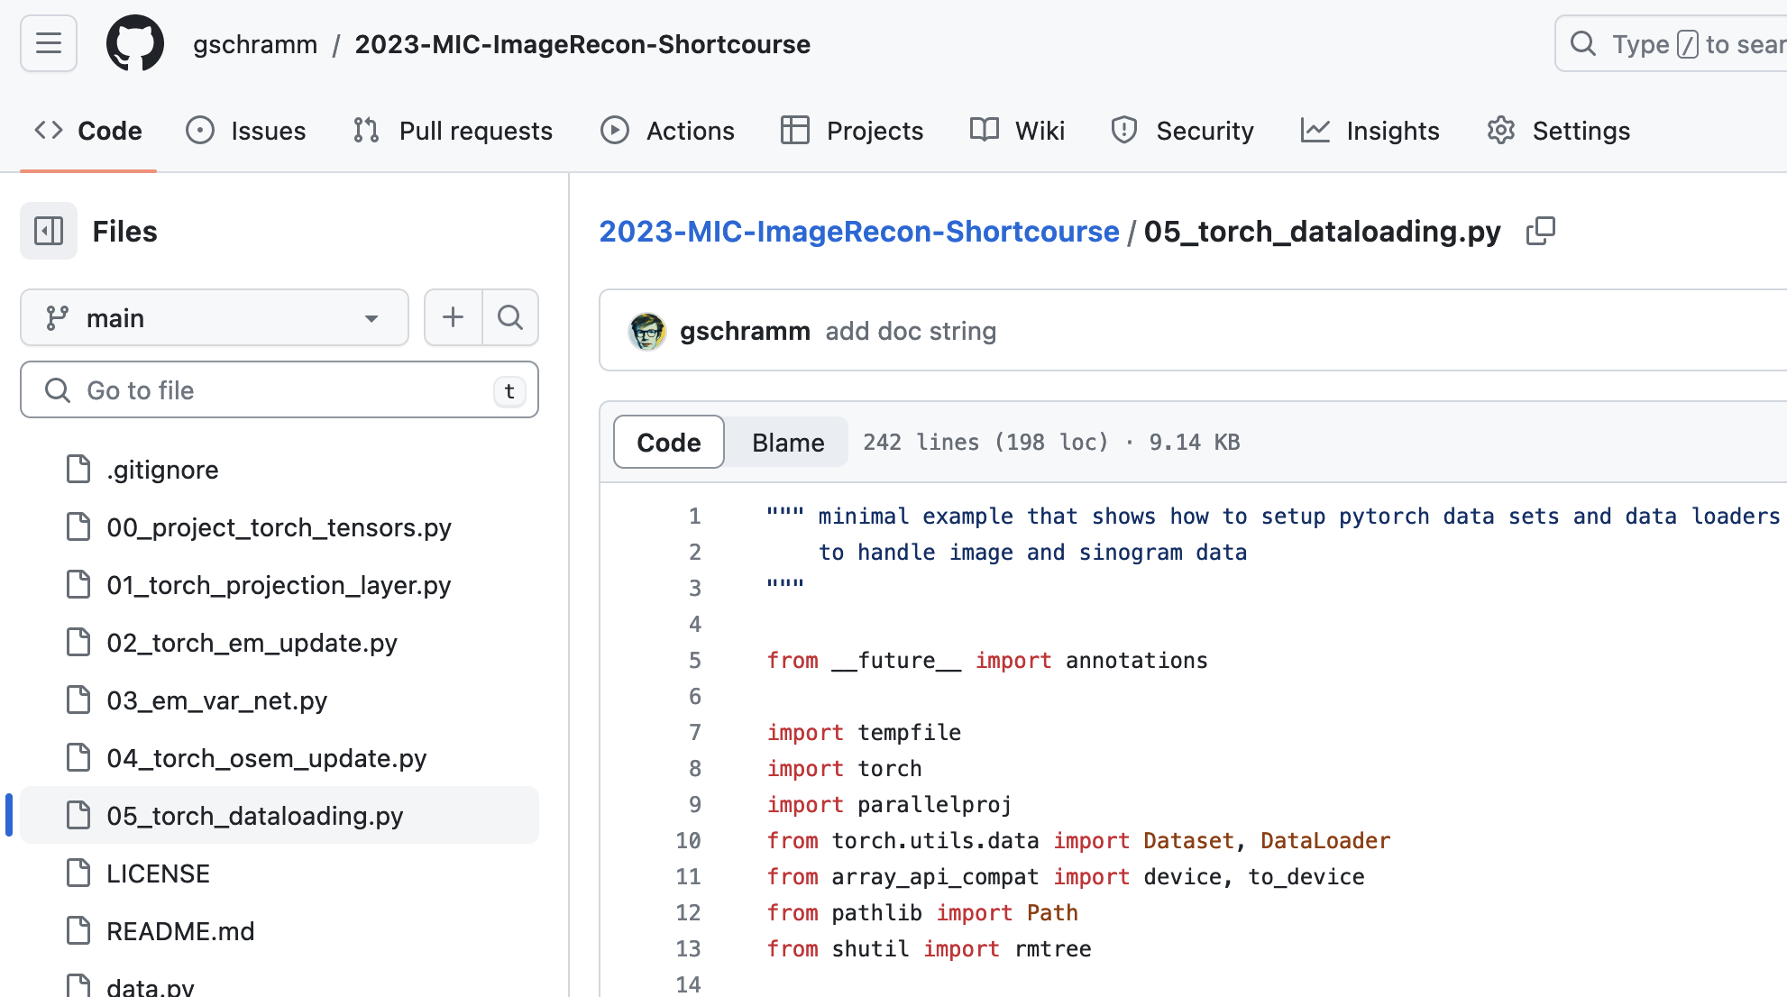
Implementing a custom image and sinogram data loader
Learning objectives V
Implement a custom pytorch PET data set consisting of images and sinograms
Implement a pytorch DataLoader that can sample mini batches
(optional) understand custom mini batch collation

Slide 31
(TOF) PET specific considerations

Slide 32
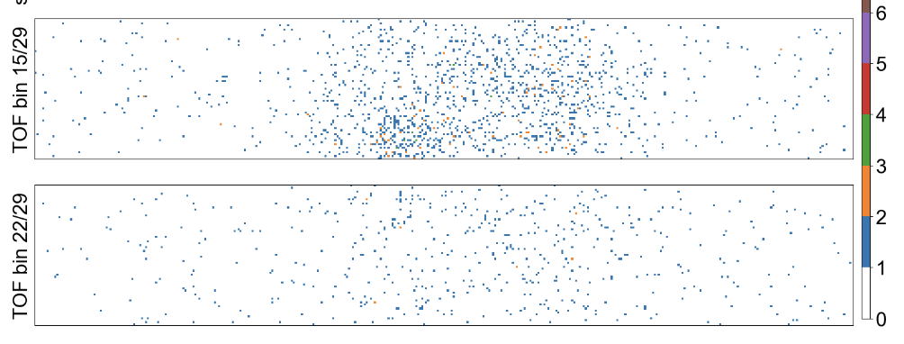
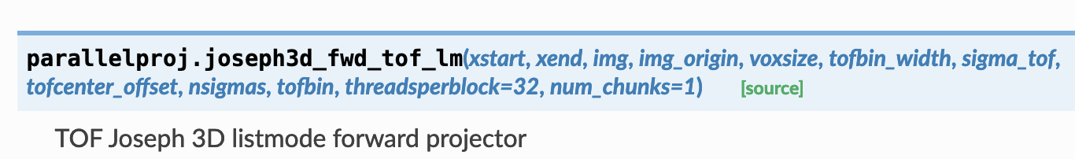
3D (TOF) PET specific considerations
Challenges for training networks with real-world PET data sets
size of (TOF) sinograms (~20GB) -> challenge for “small” GPU memory and data loading
even using GPUs sinogram projections / backprojections are still “slow” compared to convolutional and activation layers possible improvements - EM update in listmode (especially for low count input) - use of “histo images” - use of subset updates
convergence of EM updates is “slow” possible improvements: - start from “quick and dirty” OSEM reconstruction
PET images can have very different scales, NN usually require scaled inputs possible improvements: - derive sample-dependent image re-scaling factor from OSEM
20cm/400ps scanner TOF sinogram size (357,272,1261,29)

Slide 33
Putting it all together – results / show case

Slide 34
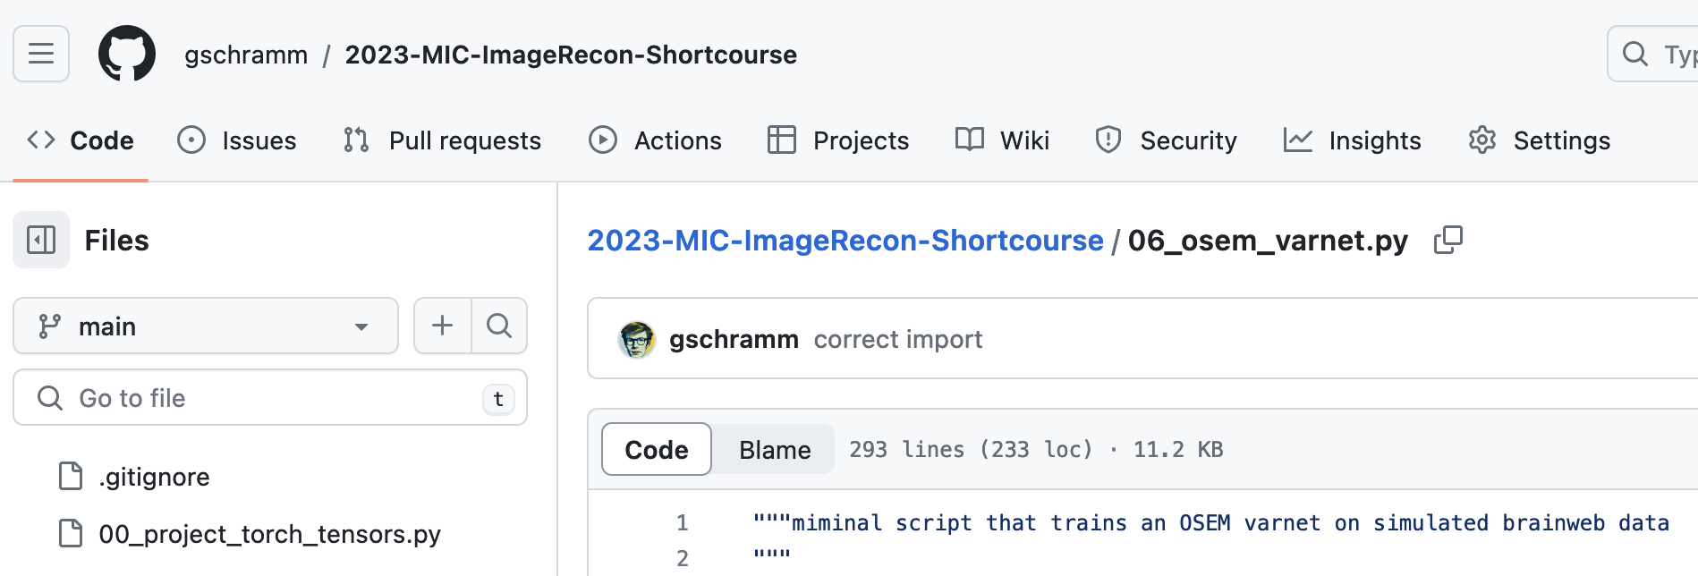
Results of a trained unrolled EMVarNet for low count PET
emission data
OSEM update
OSEM update
OSEM update
OSEM update
OSEM input
fusion
fusion
fusion
fusion
output
Unet
Unet
Unet
Unet

Slide 35
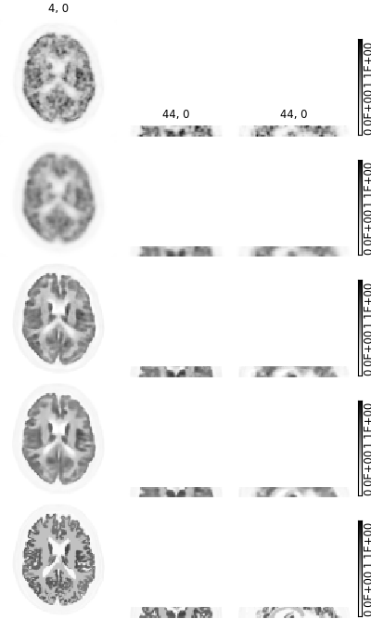
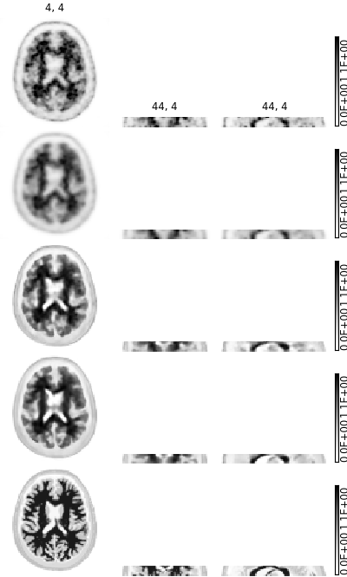
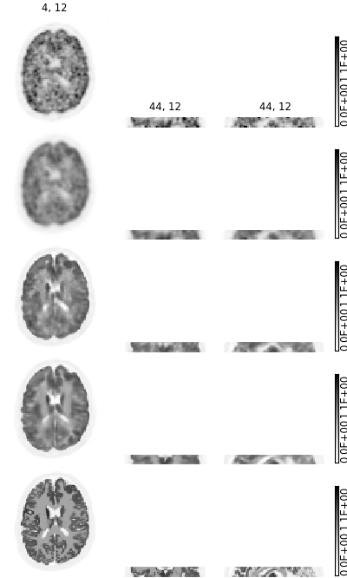
Results of a trained unrolled EMVarNet for low count PET
noisy low count OSEM input
post-smoothed OSEM
Post-recon (same) UNET
Unrolled VarNET w. UNET 8 “blocks”
high quality target image
NN-based denoising and deblurring of (public) simulated low-count PET data
target noise-free and high-res ground truth image
Comparison of unrolled OSEM VarNET using UNET to post-recon approach with same UNET architecture
Training on 40 simulated brainweb data sets (“short” 3D non-TOF PET scanner)
Validation on 20 simulated brainweb data sets
Challenge: Can you do (much) better?
MSE = 7.3E-3
MSE = 6.9E-3

Slide 36
Summary

Slide 37
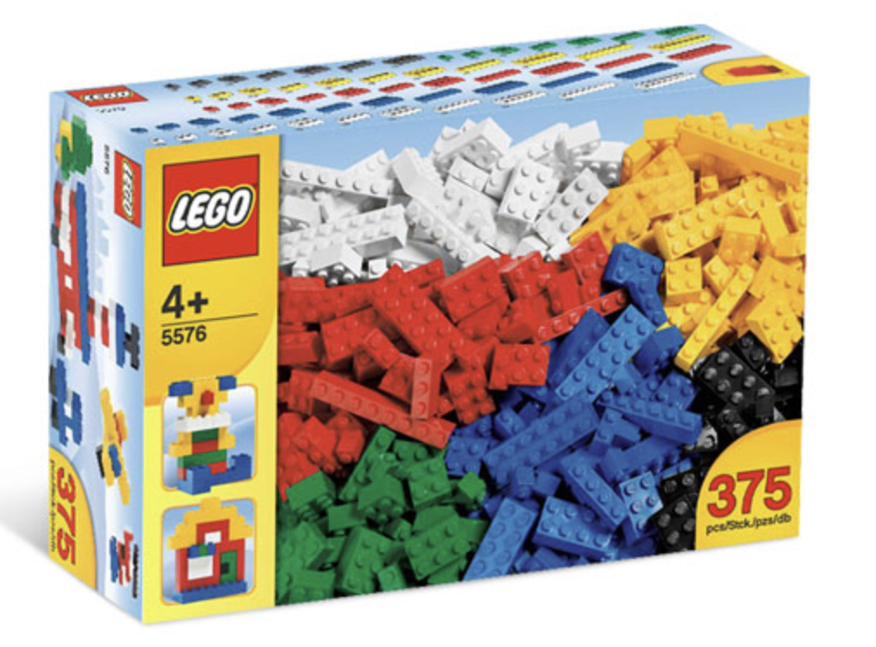
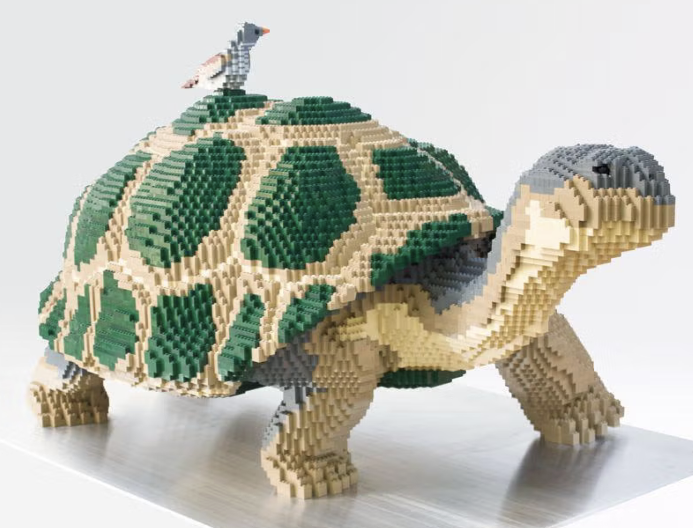
What have we learned to today?
Basic building block for setup + training a neural networks including forward / back projections
GPU projectors that can directly project GPU arrays (pytorch GPU tensors) -> e.g. parallelproj
projection layers compatible with pytorch’s autograd
Simple (Poisson) EM-update modules using projection layers
combining EM-update module and NNs into an unrolled VarNET
pytorch’s datasets and dataloader classes
From basic blocks to complex networks!
https://slate.com/human-interest/2015/08/sean-kenneys-nature-connect-lego-animal-sculptures-are-featured-in-beautiful-lego-wild-things.html

Slide 38
What we didn’t talk about / points to consider
reading / interpreting real data sets
meaningful evaluation of image quality
comparison against existing (non-learning-based) methods
Thank you
Feedback or comments?
Interested in setting up a recon challenge? georg.schramm@kuleuven.be

